Slide 1
Distribution Systems
J. G. Weisend II
www.europeanspallationsource.se
Winter 2025

Slide 2
Goals
Describe the nature, performance and design considerations of Transfer Lines, Distribution Systems and Distribution (valve) boxes in cryogenic systems
Show examples of typical components
Thanks to Tom Peterson (SLAC) and Jarek Fydrych (ESS) for significant contributions.

Slide 3
Transfer Lines
Vital part of a cryogenic system
  Transfers cryogenic fluids between components
  Essentially a long cryostat
  Can be a significant part of system cost and heat leak
  Can be acquired commercially or custom built
Key design issues
  Thermal contraction (significant due to long lengths)
  Heat Leak (use of active thermal shields)
  Forces generated by fluid pressure, thermal contraction must be managed so as to not impact alignment of components
  Vacuum integrity (pump outs, relief valves and vacuum barriers)

Slide 4
Transfer Line Example
Fermilab Tevatron
Note that the cooling pipes are concentric

Slide 5
Transfer Line Example
Fermilab Tevatron

Slide 6
Most Transfer Lines today have parallel rather than concentric piping arrangements
From J. Frydrych
”Transfer Lines” in Cryostat Design

Slide 7
Examples of Transfer Line
Cross sections
From J. Frydrych ”Transfer Lines” in Cryostat Design

Slide 8
DESY XFEL/ AMTF Transfer Line
From J. Frydrych ”Transfer Lines” in Cryostat Design
Designed and built by WUST and KrioSystem
They team also provided the bulk of the ESS distribution system

Slide 9
DESY XFEL/ AMTF Transfer Line
From J. Frydrych ”Transfer Lines” in Cryostat Design

Slide 10
DESY XFEL/ AMTF Transfer Line
From J. Frydrych ”Transfer Lines” in Cryostat Design

Slide 11
ESS Transfer Line between ACCP & start of Cryogenic Distribution System
From J. Frydrych ”Transfer Lines” in Cryostat Design

Slide 12
Transfer Lines
Methods to address thermal contraction
  Have a combination of fixed and sliding supports on the interior pipes separated by bellows.
  Use bends to allow interior pipes to contract
  Use Invar pipes to reduce amount of thermal contraction (CERN/LHC)

Slide 13
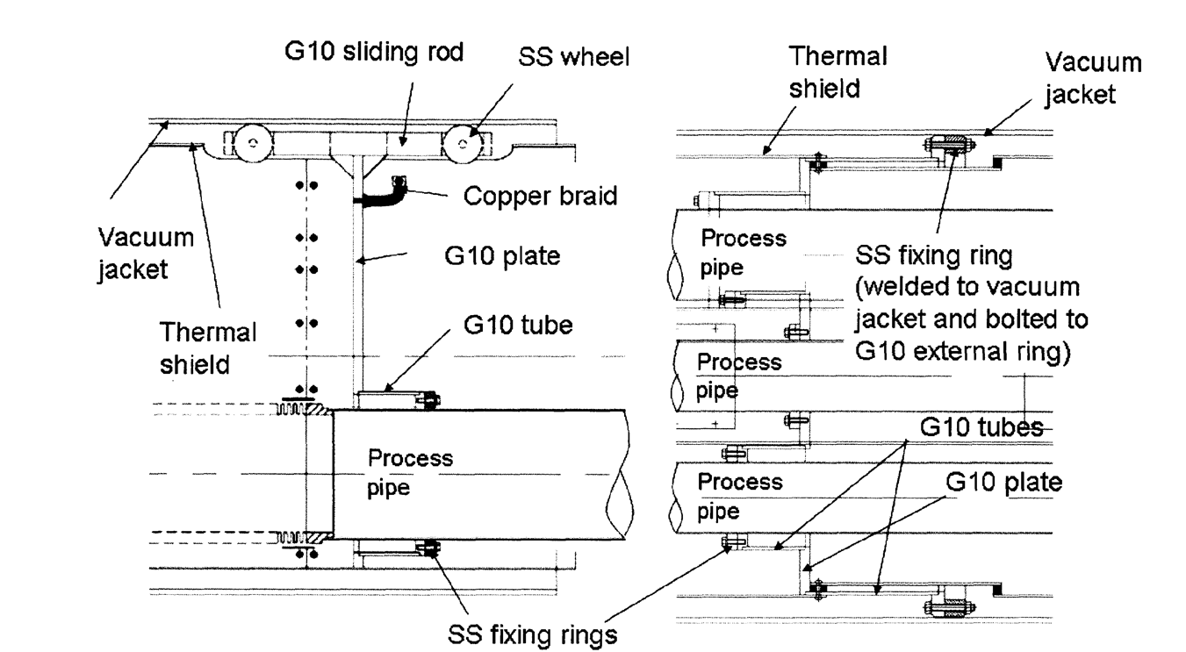
“The Local Helium Compound Transfer lines For The Large Hadron Collider
Cryogenic System”
C. Parente et al. Adv. Cryo Engr. Vol 51 (2006)

Slide 14
Typical Interconnection Between Transfer Line Segments
From J. Frydrych ”Transfer Lines” in Cryostat Design

Slide 15
Vacuum Barriers
Common in transfer lines and distribution systems.
Divides isulation vacuum space into separate sections
Must allow internal pipes to pass through
Allows
  Leak checking and trouble shooting
  Reduces impact of vacuum leaks and sudden vacuum failures
  May allow for separate warm up and cool down of sytem components (ESS)

Slide 16
Example of a Vacuum Barrier

Slide 17
Some Reported Heat Loads for Transfer Lines

Slide 18
Example Transfer Line Costs
Note that these numbers are for simple transfer lines, once complicated distribution boxes are included the costs grow significantly

Slide 19
Complicated Transfer Lines Become Distribution Systems

Slide 20
Distribution System Example : ESS
Cryogenic System of the Optimus Linac
Accelerator
Cryoplant
Cryogenic
Transfer
Line (75 m)
Cryogenic Distribution Line (310 m)
comprising 43 valve boxes
Auxiliary process lines
Endbox
Splitting
box
21 High Beta
Cryomodules
(174 m)
9 Medium Beta
Cryomodules
(75 m)
13 Spoke
Cryomodules
(54 m)
Superconducting section of the Optimus Linac (303 m)

Slide 21
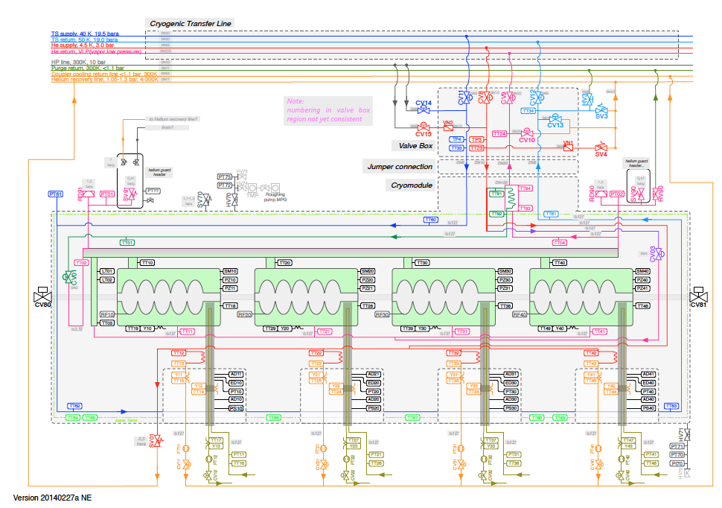
Connection between Elliptical Cavity CM and Cryogenic Distribution Line
Allows independent CD/WU of cryomodules

Slide 22
CDS-EL Components installation in Tunnel

Slide 23
Distribution System Example : LCLS II

Slide 24
LCLS II Feedcaps 2 and 4
A. Klebaner (FNAL) & DEMACO

Slide 26
Distribution or Valve Boxes
Provide connections between cryoplants, components to be cooled and transfer lines
End Boxes and Feed Boxes at the ends of cryogenic sections
Generally complicated, custom designed components. They may contain:
  Valves: control, shut off, relief etc
  Heat exchangers
  Liquid reservoirs
  Heaters
  Instrumentation
  Current leads
  Connections to warm systems

Slide 27
Example # 1

Slide 28
Example # 2

Slide 30
DFBX Under Construction

Slide 31
Conclusions
Transfer lines, distribution systems and valve boxes are an important part of cryogenic systems
They have unique challenges and may be quite complex
They can constitute a significant amount of both cost and schedule
Do not under estimate the amount of time and money to successfully create these components
Full scale prototyping say in a test facility is highly advised to reduce risk.

